Slide 1
Practical Applications of Distributed IoT Systems
Iván García-Magariño
Department of Software Engineering and Artificial Intelligence
Complutense University of Madrid, Spain
igarciam@ucm.es

Slide 2
Outline
Introduction
Distributed systems for measuring IoT devices for measuring memory in Activity of Daily Life
Two Case Studies:
  Assessment of Navigation patterns for measuring memory and disorientation in 3D simulations
  Real and novel smart cupboard in kitchen for measuring Memory
Application of Human-centric Artificial Intelligence

Slide 3
Introduction
Problem:
Alzheimer is one of the most prevalent disorders
The main symptom is loss of memory
Measuring memory requires effort from the subjects
Continuous Tracking memory usually requires a high level of commitment
Proposed solution:
Internet of Things (IoT) devices for tracking memory of people by just analyzing their daily activities

Slide 4
IoT for Measuring Activities in Daily Life
Actions that they reflect they forget something:
where they left some keys, their shoes, clothes or food
whether they have changed their clothes
whether they have had a shower
Most of these actions can be tracked by IoT devices in houses
Presence Sensors
Smart cupboards
Smart wardrobes
Smart taps

Slide 5
Algorithms for assessing memory and detecting disorientation
Reference:
García-Magariño, I., Cárdenas, M., Gómez-Sanz, J., & Pérez Díez (2019). Framework-supported mechanism of testing algorithms for assessing memory and detecting disorientation from IoT sensors . In 5th IEEE World Forum on Internet of Things (WF-IoT) 2019. Limerick, Ireland, April 15-18 2019. IEEE
Main aspects:
Use of Presence sensors
Detecting Navigation Patterns

Slide 6
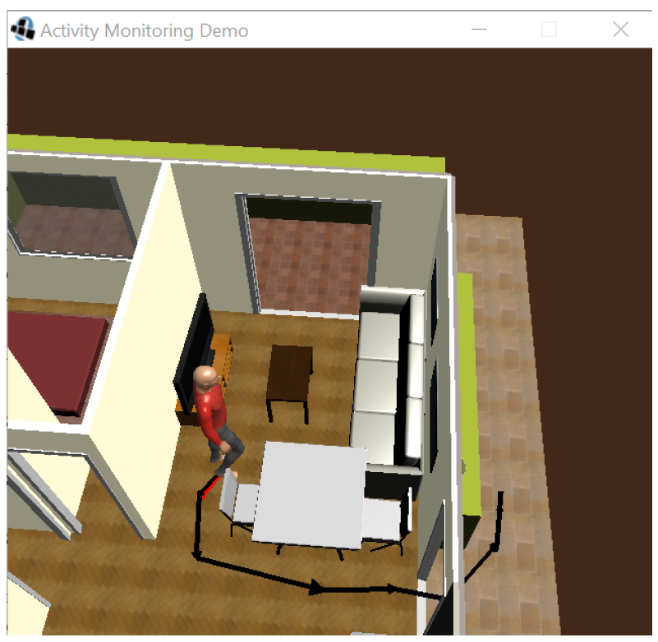
Navigation patterns simulated in AIDE 3D simulation platform
AIDE (developed by Grasia research group)

Slide 7
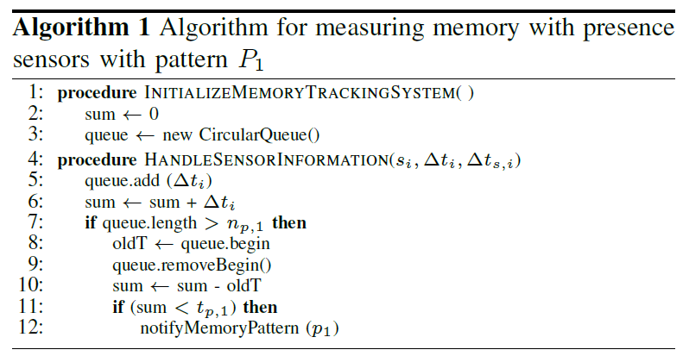

Slide 8
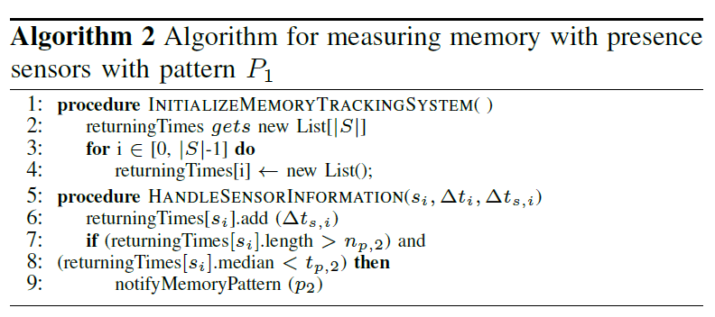

Slide 9
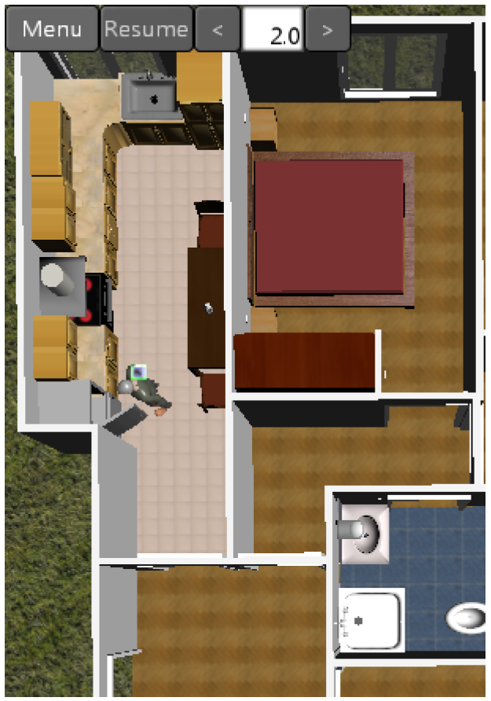
Example of the avatar opening the fridge

Slide 10
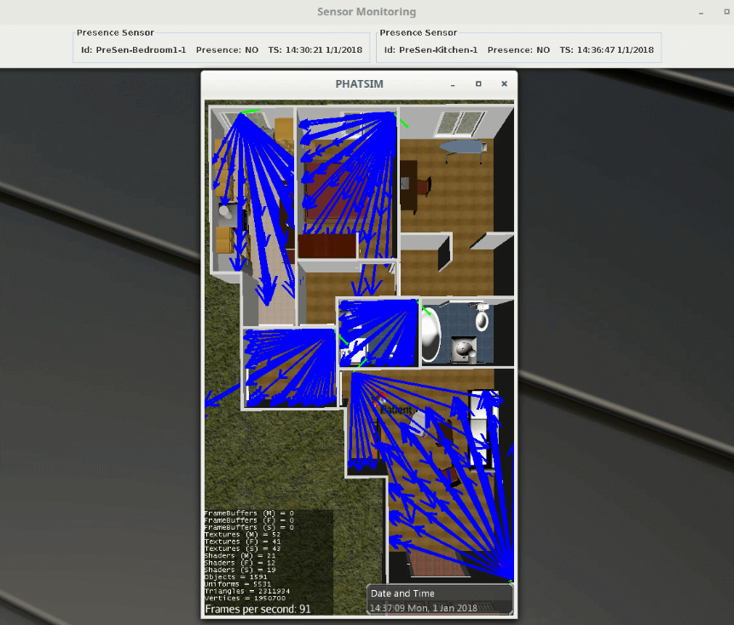
Presence
Sensors in
simulations

Slide 11
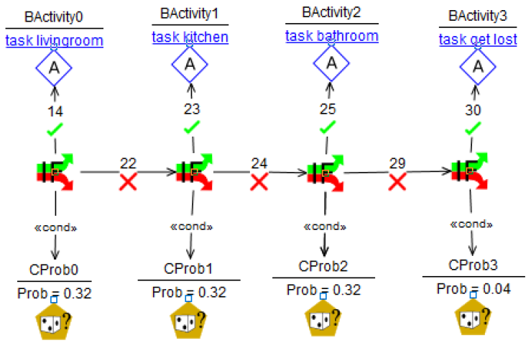
Modelling avatar behaviors

Slide 12
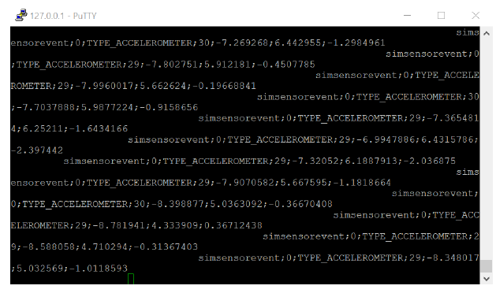
Example of information transmitted to ports in simulations

Slide 13
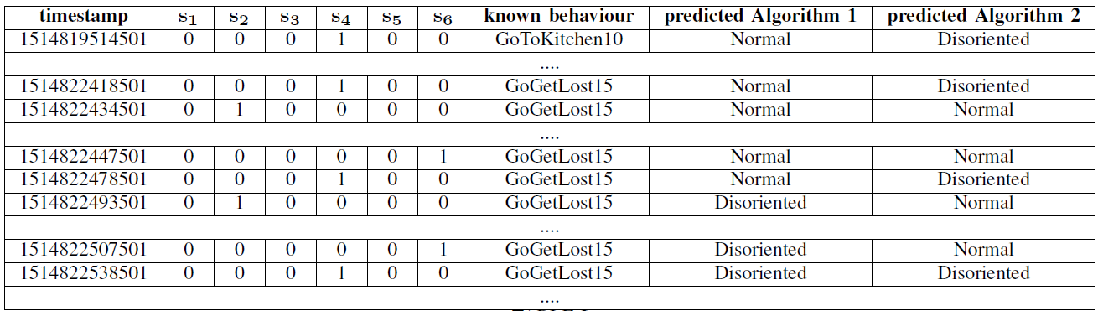
Example of analysing each simulation

Slide 14

Results of the analysis of simulated navigation patterns

Slide 15
A case Study: A smart cupboard
International collaboration between:
  University Complutense of Madrid, Madrid, Spain
  Edison Desarrollos Company, Teruel, Spain
  Harvard University, Boston, United States of America
  Massachusetts General Hospital, United States of America
  University of Zaragoza, Teruel, Spain
Publication in international journal with impact:
  González-Landero, F., García-Magariño, I., Amariglio, R., & Lacuesta, R. (2019). Smart Cupboard for Assessing Memory in Home Environment. Sensors, 19(11), 2552.
Available in TeleMadrid television, RCN Radio Colombia and more than 10 newspapers.

Slide 16
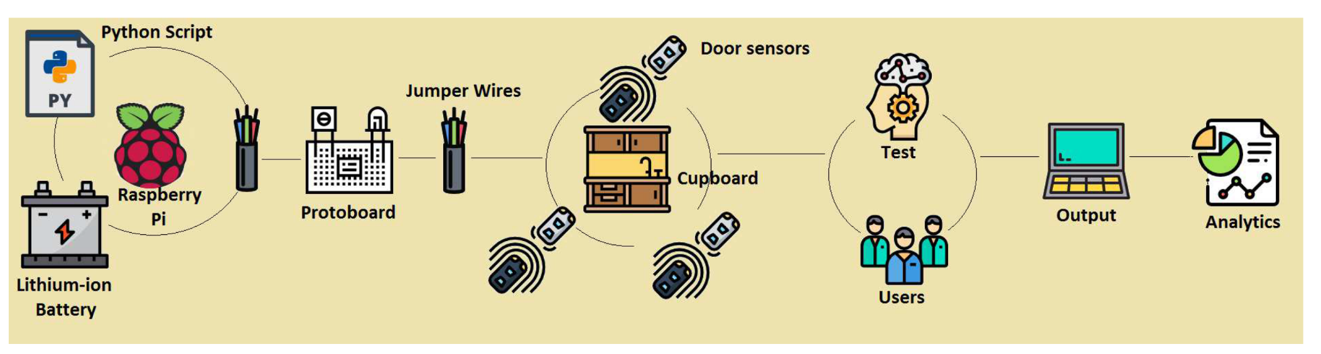
Overview of the Smart Cupboard approach

Slide 17
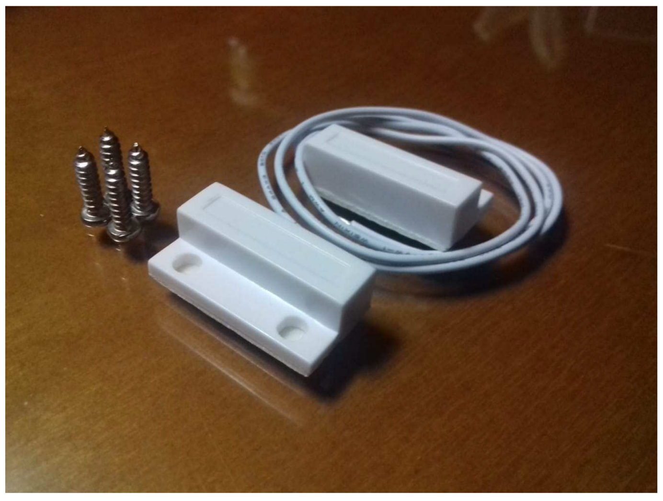
Magnetic Door Sensor

Slide 18
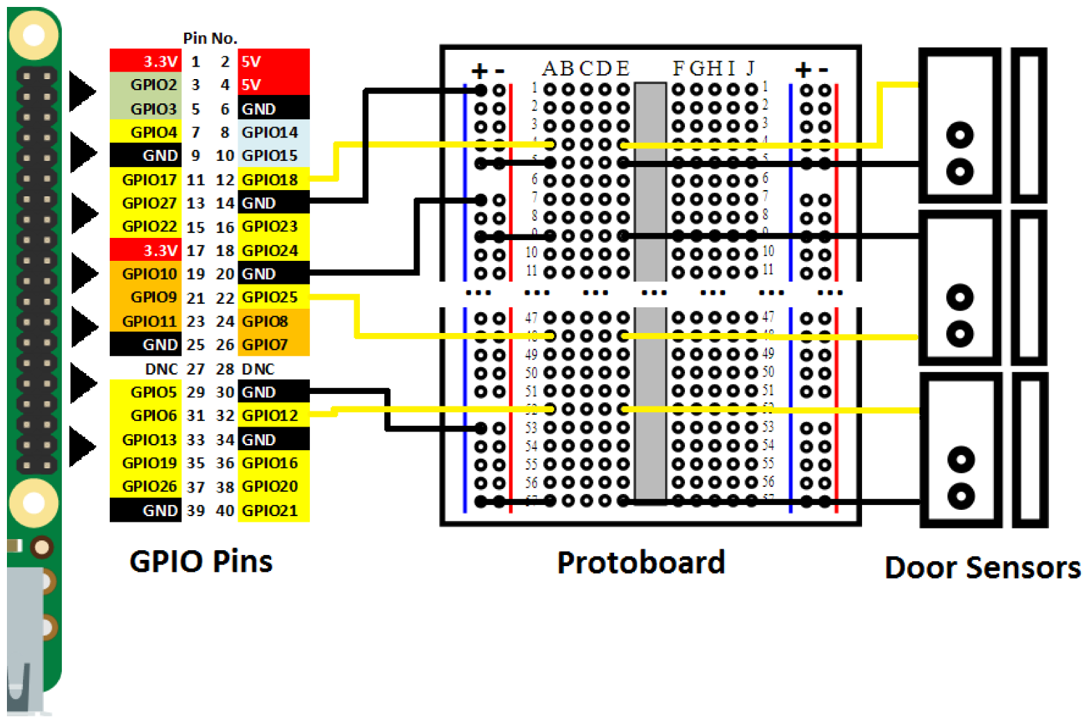
Schema of the Connections

Slide 19
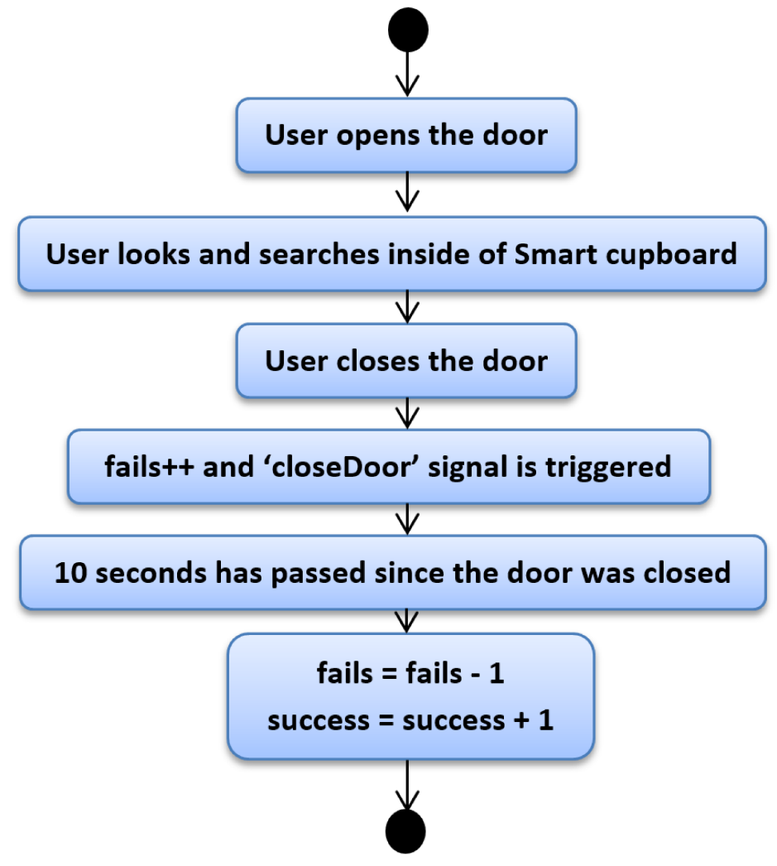
Normal Use of Smart Cupboard: Sequence of Actions

Slide 20
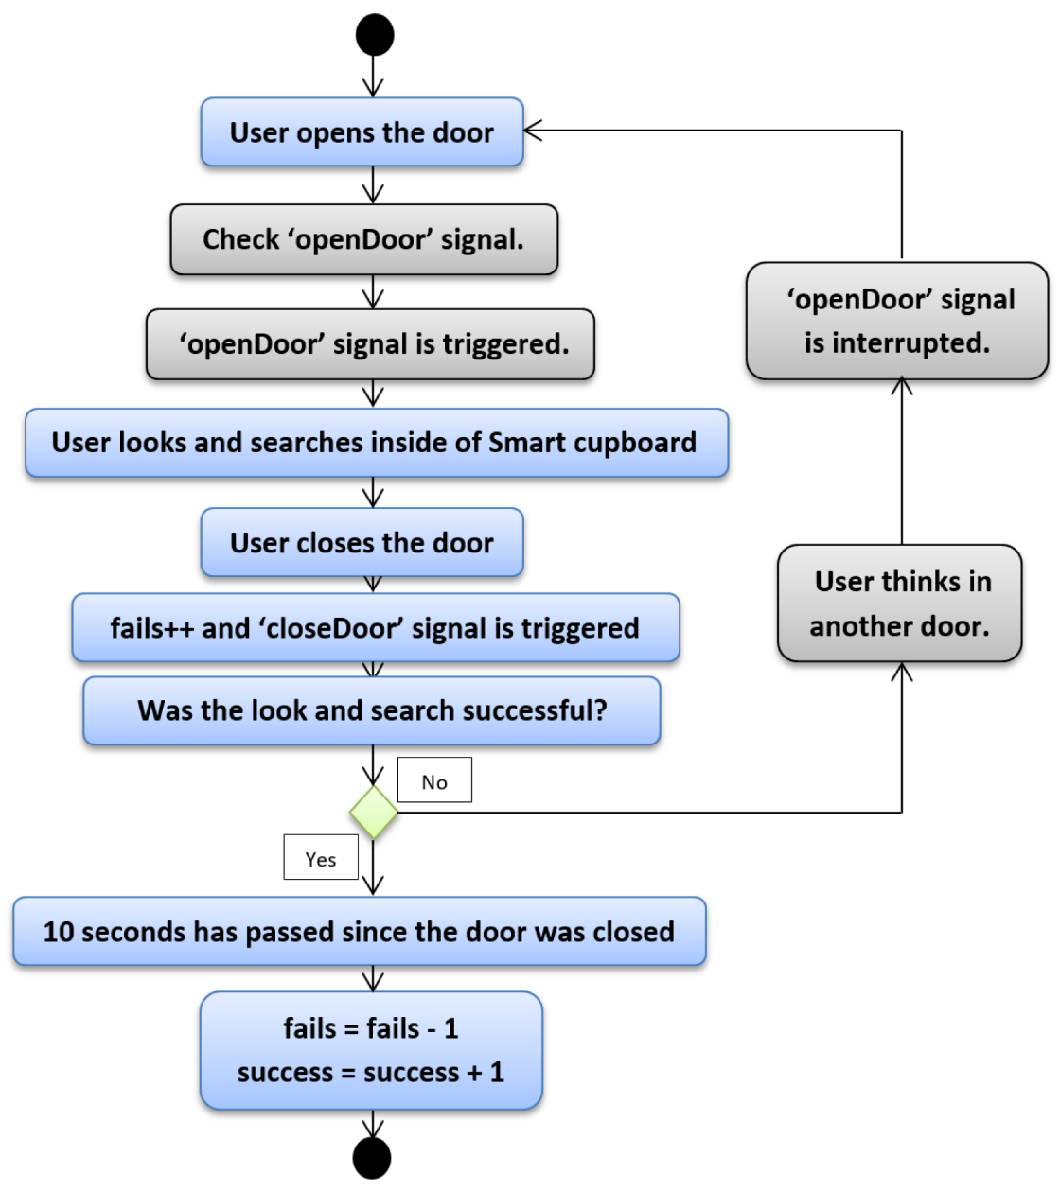
User Forgets the Location of something- Detection

Slide 21
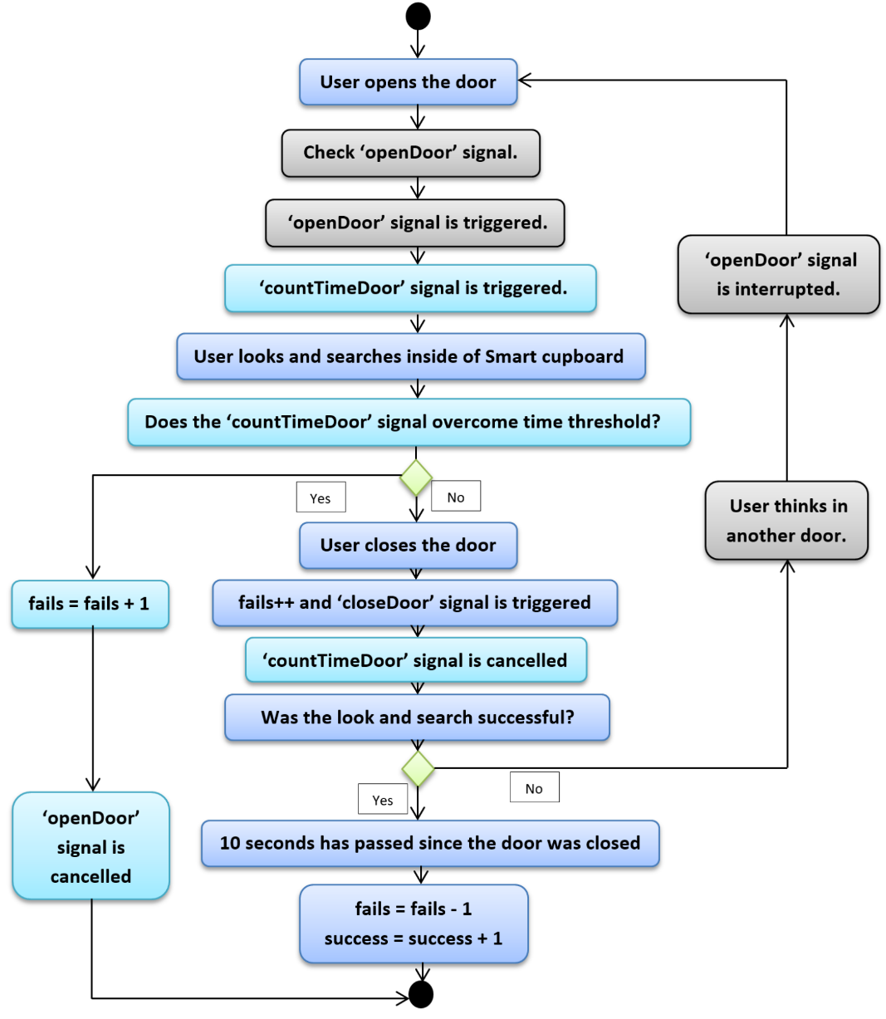
User keeps looking inside a compartment for a long time

Slide 22
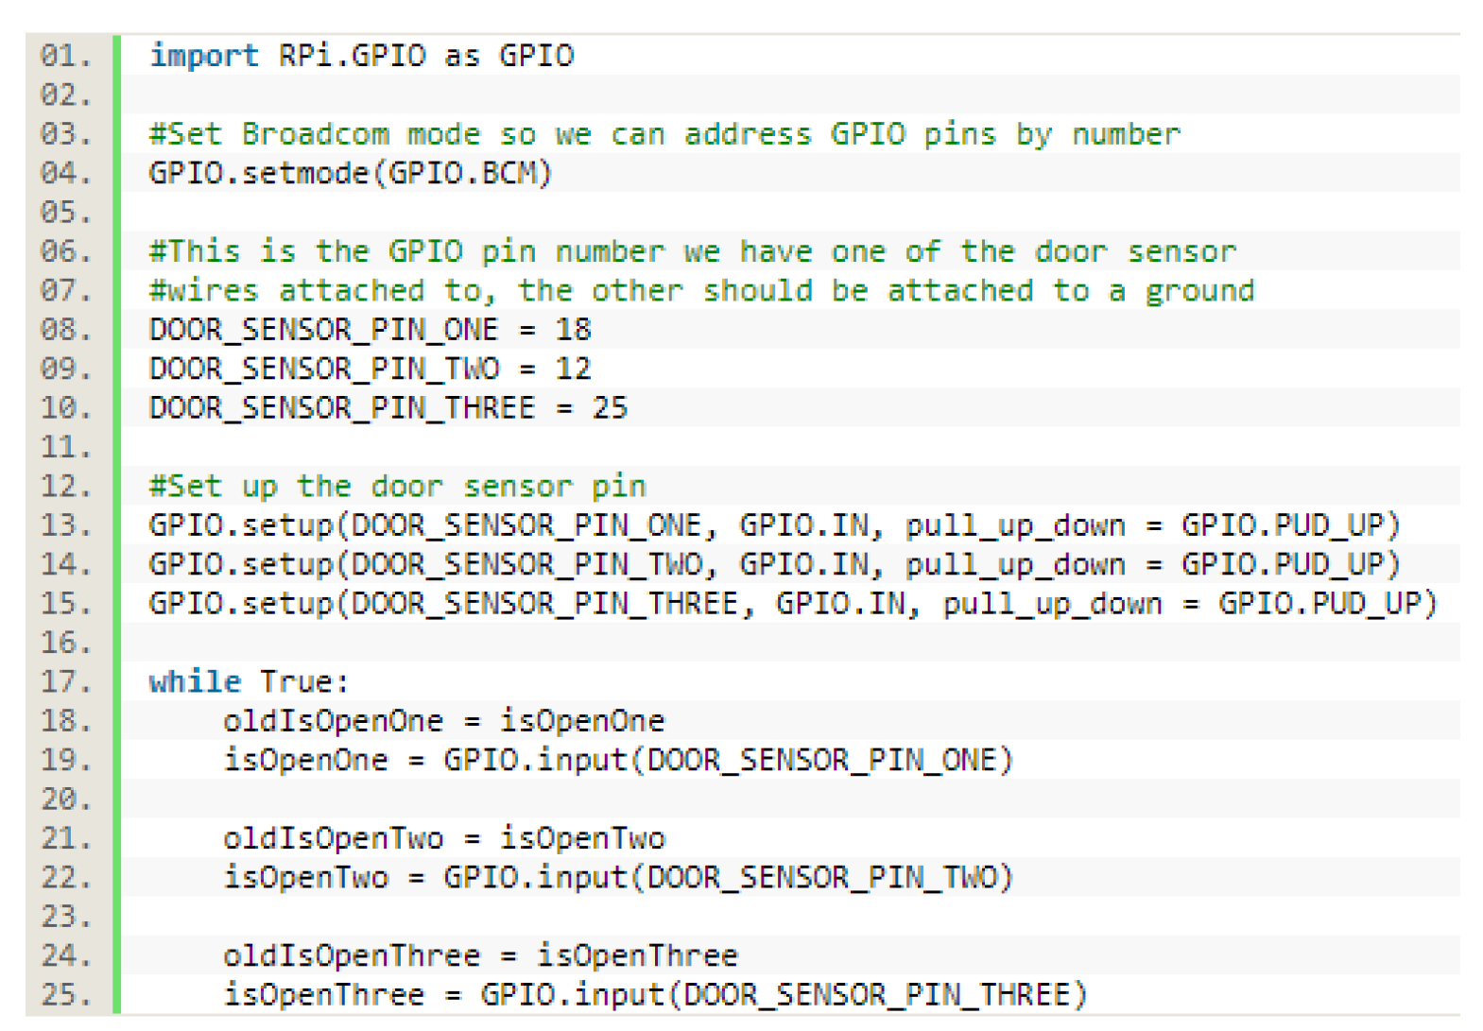
Implementation Details

Slide 23
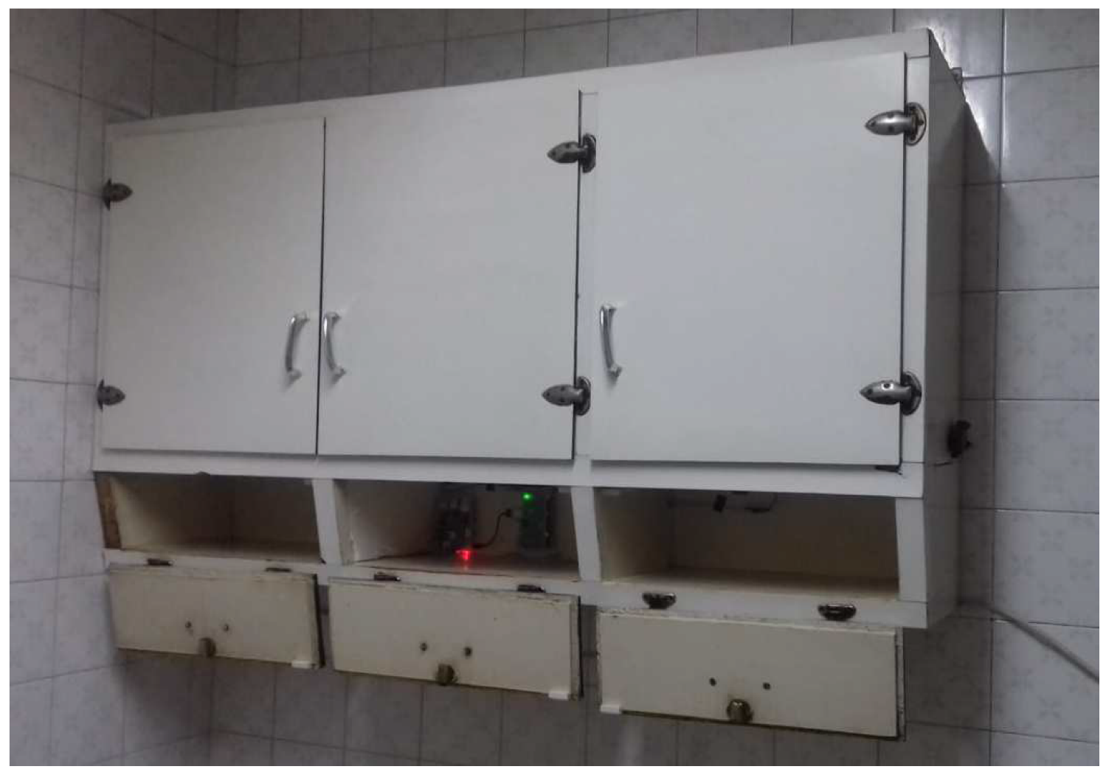
Smart Cupboard Assembled

Slide 24
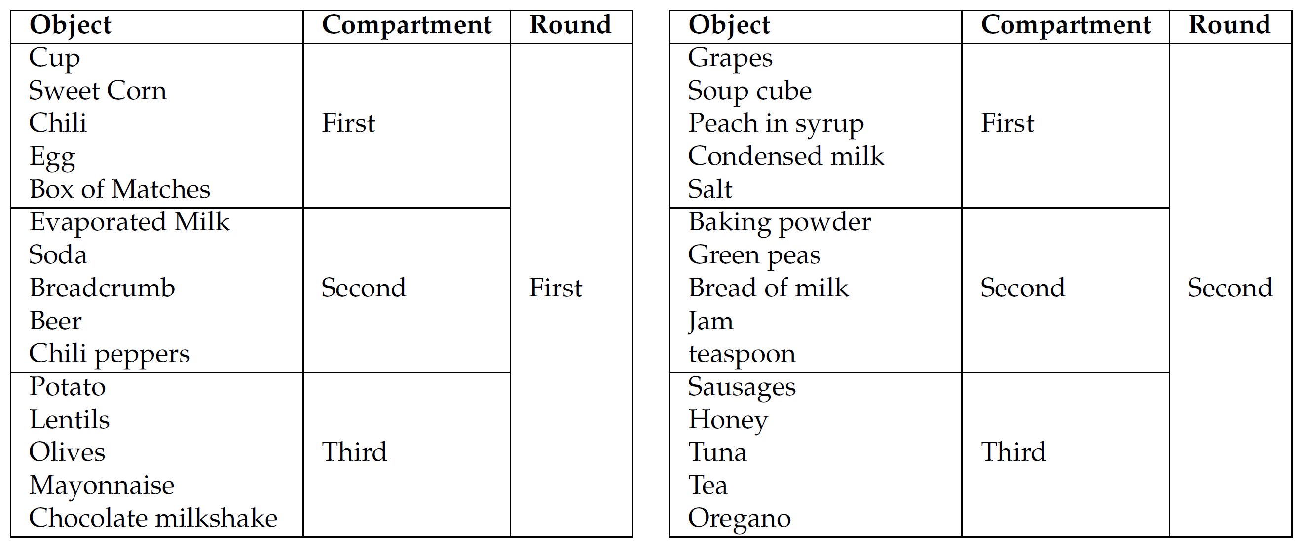
Experimentation
Order of Objects in the Experimentation
(random to avoid reasoning for retrieving location)

Slide 25
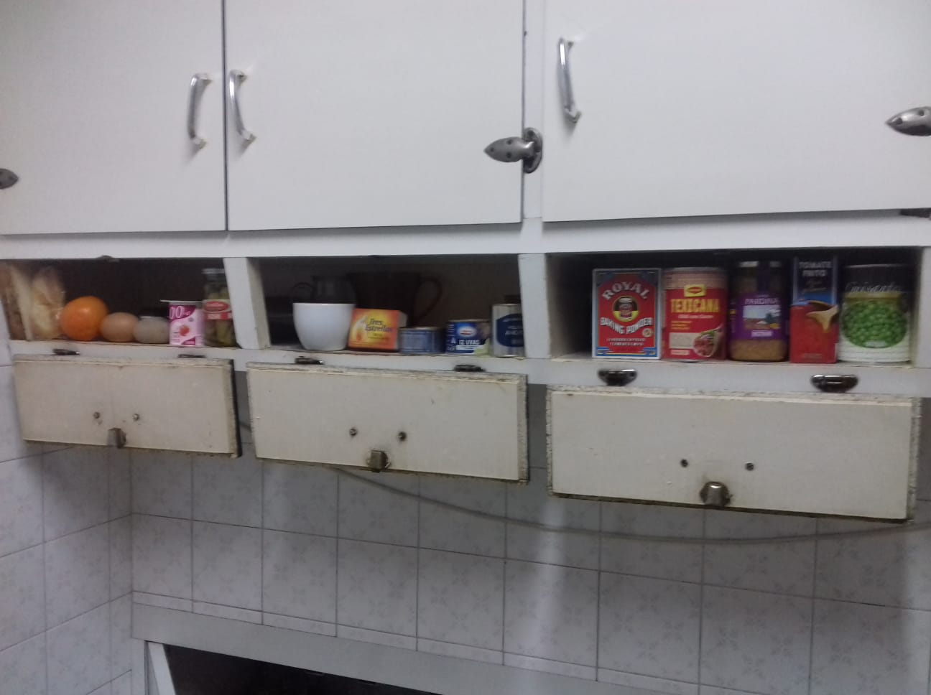
Example of Distribution of Food for Experiments

Slide 26
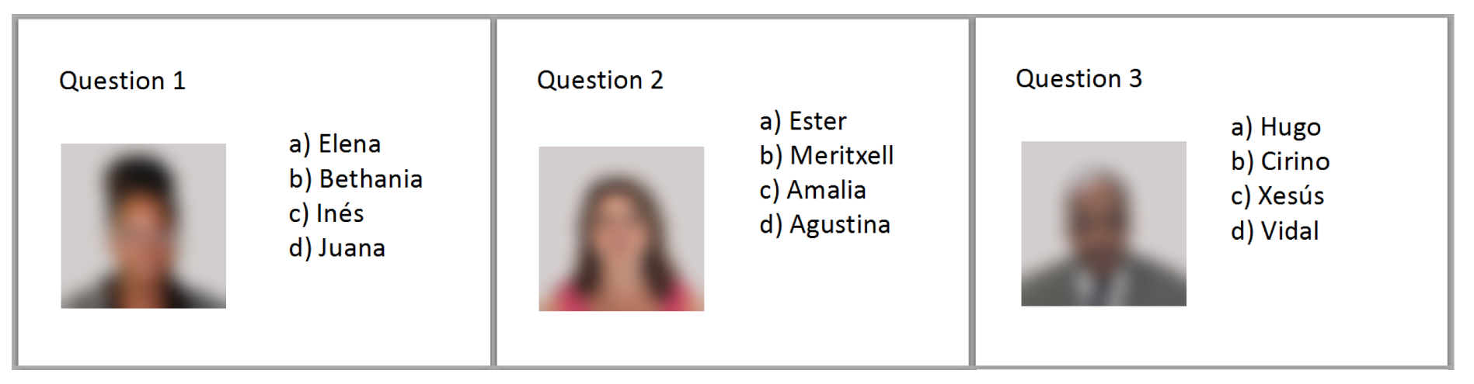
Control Test
Test of Face-Name pairs
(well-known and validated in the literature)
Self-reported test
- Do you have difficulty in remembering people’s names or phone numbers?
- How often do you find yourself trying to remember the location of everyday items (e.g.,
your keys, wallet, glasses, etc.)?
- How often do you have to replace passwords (numerical or verbal) because you’ve
forgotten the original one?
- How often do you find yourself asking questions like,
“What was I about to do next?”
…

Slide 27
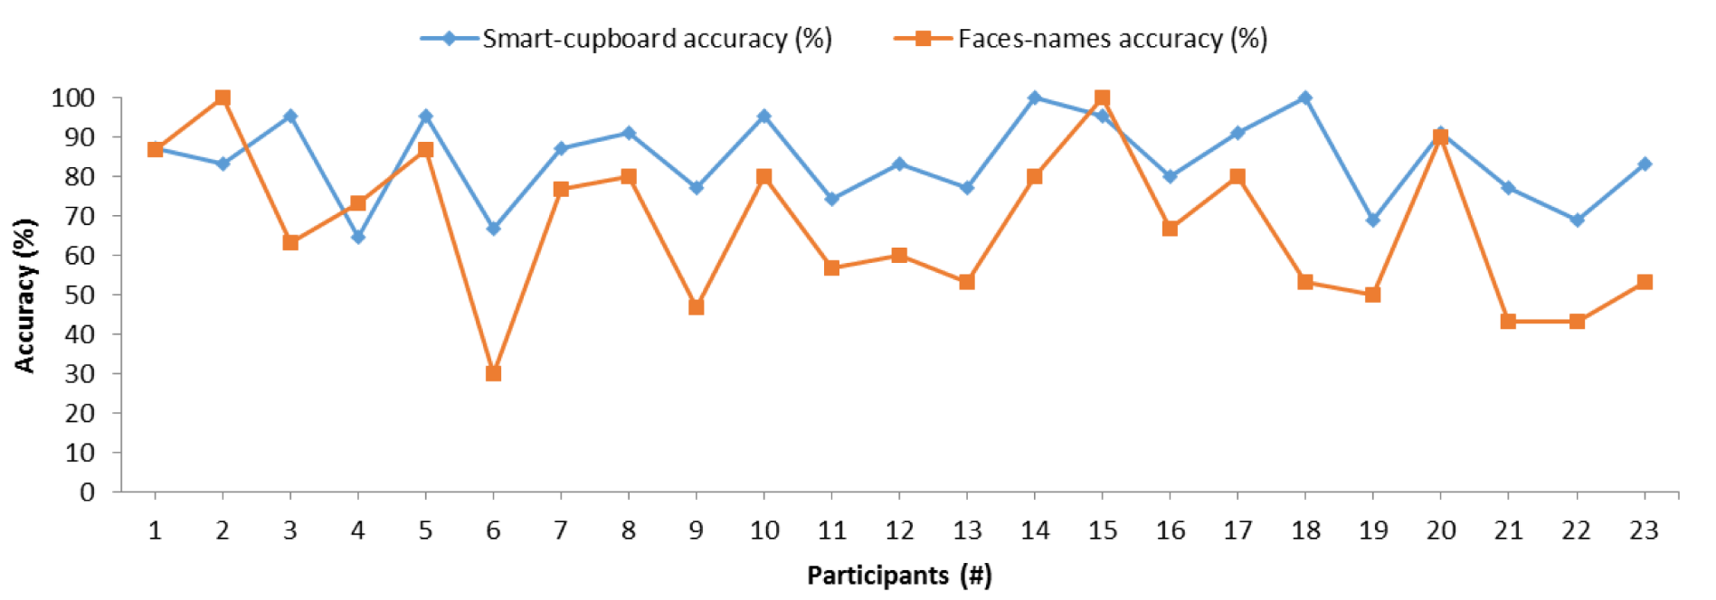
Comparison of Accuracies of Smart cupboard and Face-names

Slide 28
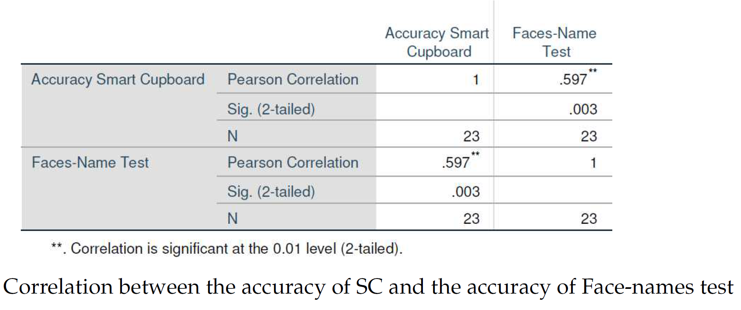
Comparison of Accuracies of Smart cupboard and Face-names

Slide 29
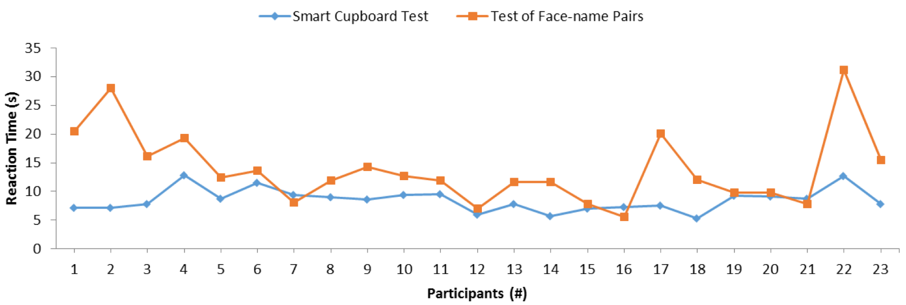
Comparison of Reaction Times

Slide 30
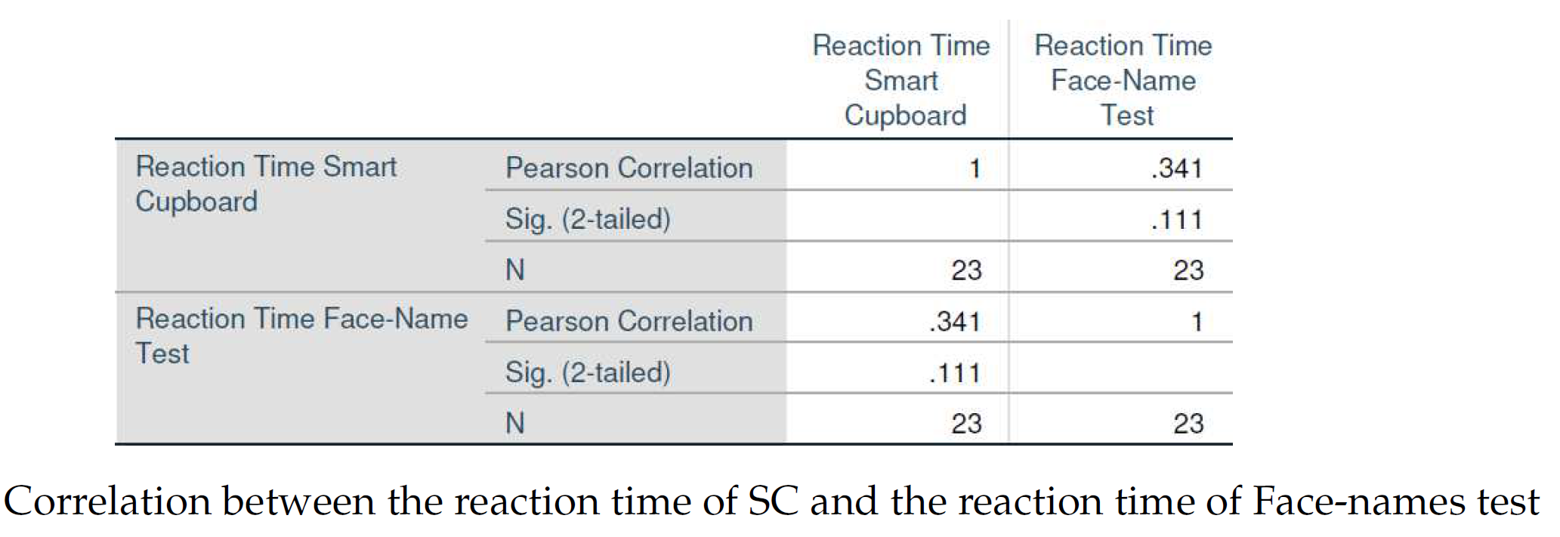
Comparison of Reaction Times

Slide 31
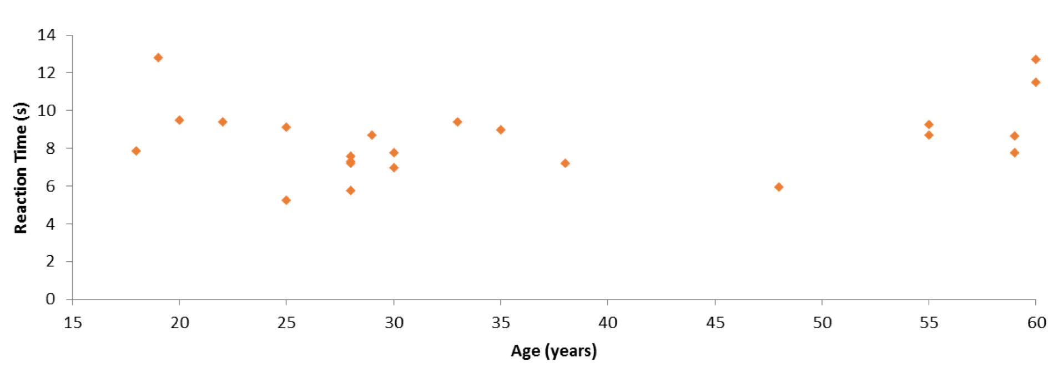
Reaction time in smart cupboard and Age

Slide 32
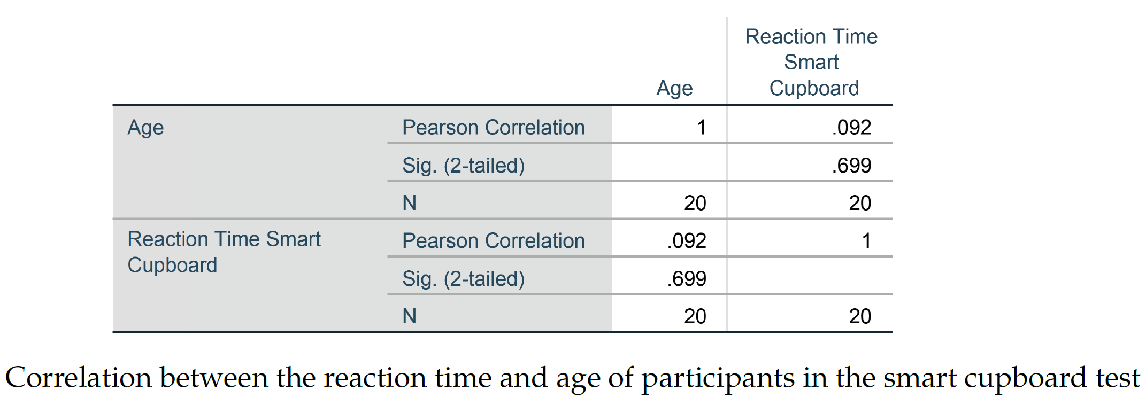
Reaction time in smart cupboard and Age

Slide 33
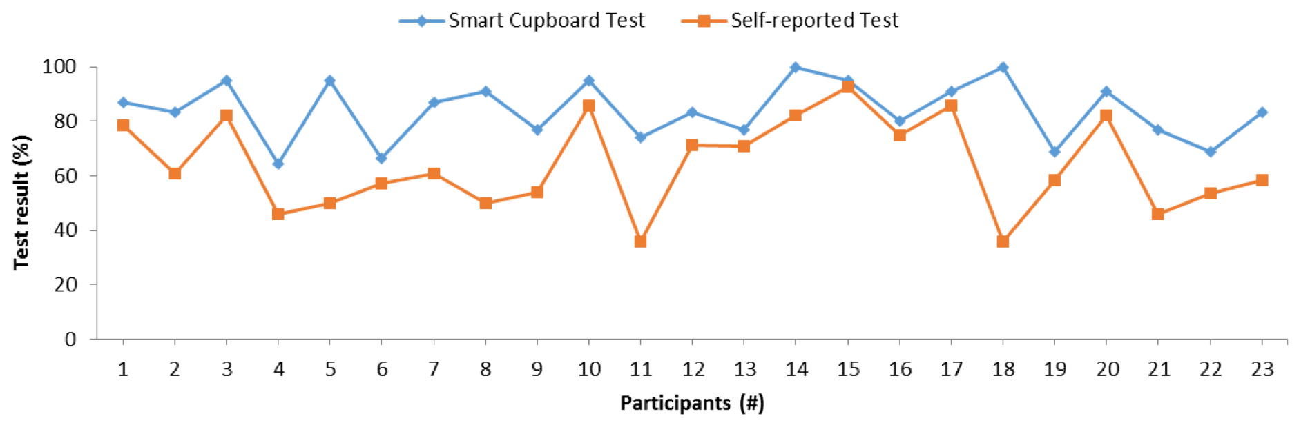
Comparison of Smart Cupboard and Self-Reported Test

Slide 34
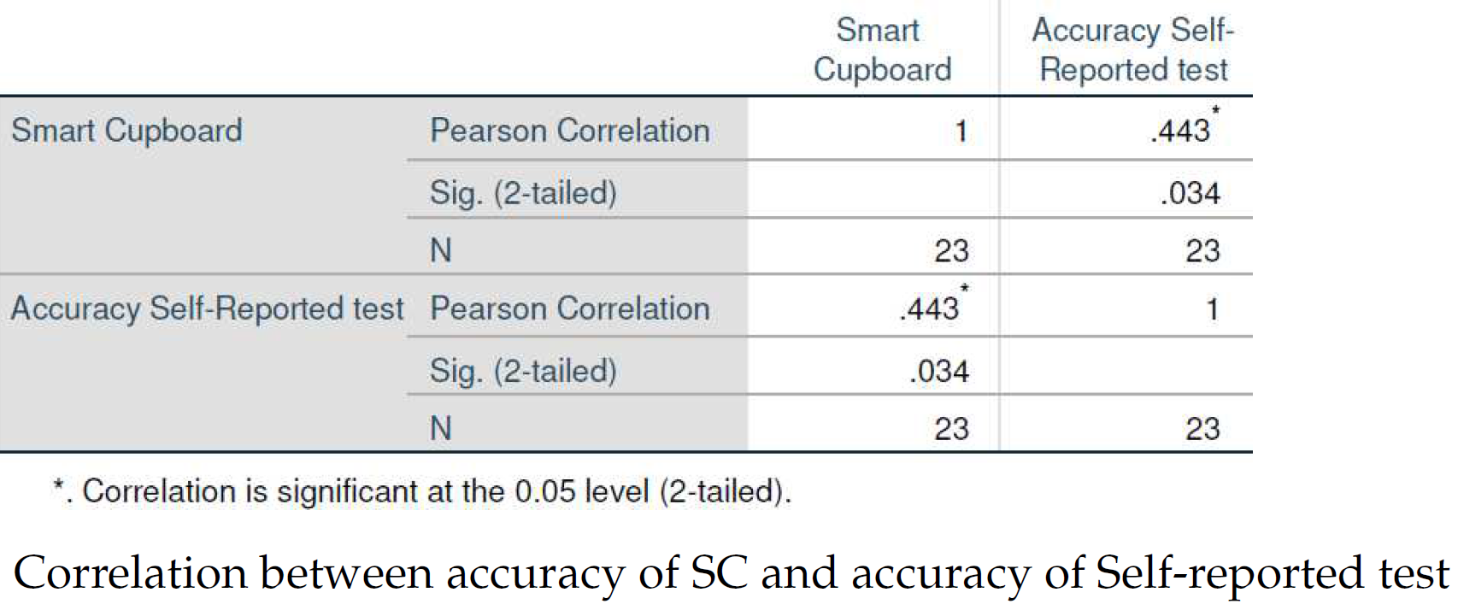
Comparison of Smart Cupboard and Self-Reported Test

Slide 35
Human-Centric Artificial Intelligence in smart kitchens
Reference:
  García-Magariño, I., Muttukrishnan, R., & Lloret, J. (2019). Human-centric AI for trustworthy IoT systems with explainable multilayer perceptrons . IEEE Access, 7 (1), 125562-125574
International Collaboration
  University Complutense of Madrid, Spain
  City, University of London, United Kingdom
  Polytechnical University of Valencia, Spain
Concept:
  Auto-generate easy-to-understand explanations

Slide 36
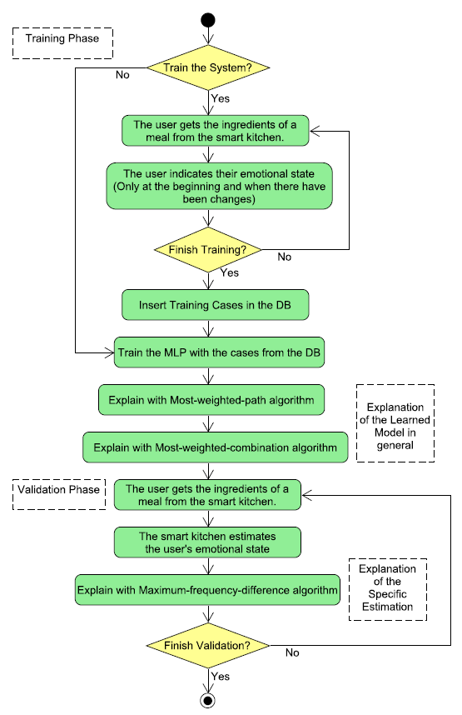
Approach for experimenting
HAI algorithms in simulated
smart kitchens

Slide 37
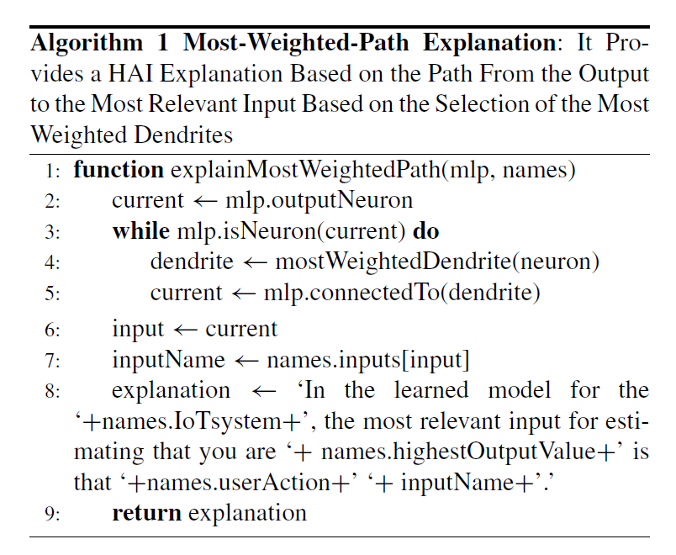

Slide 38
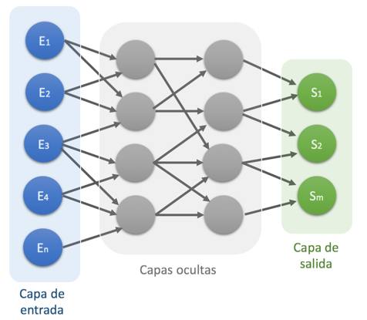
Esquema de Red Neuronal MLP

Slide 39
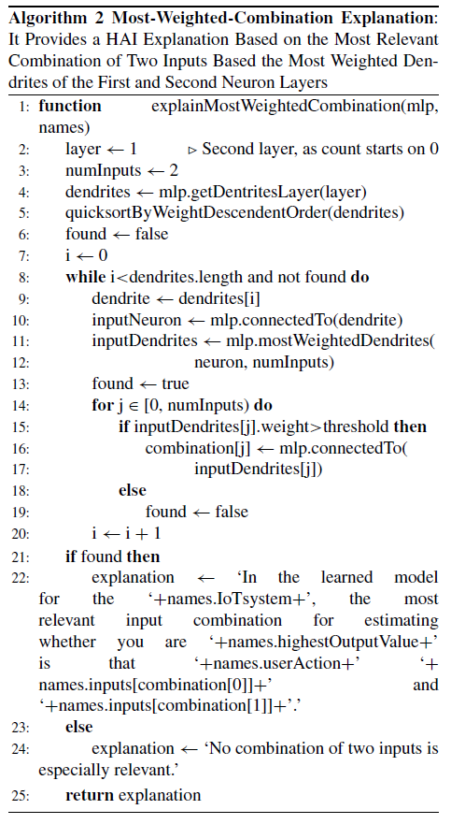

Slide 40
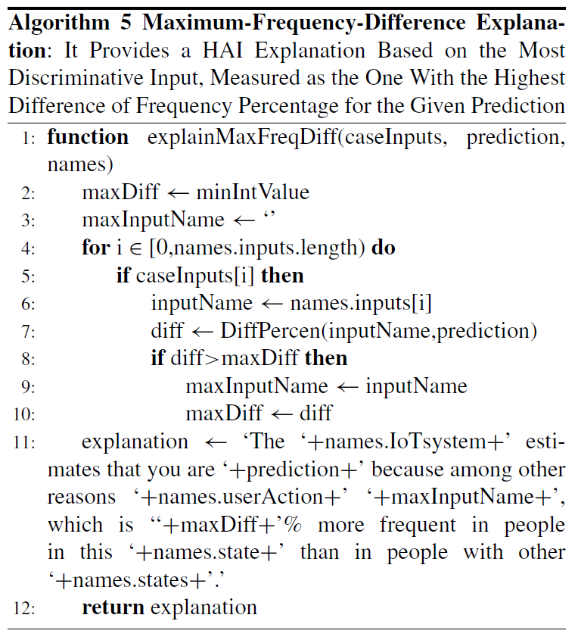

Slide 41
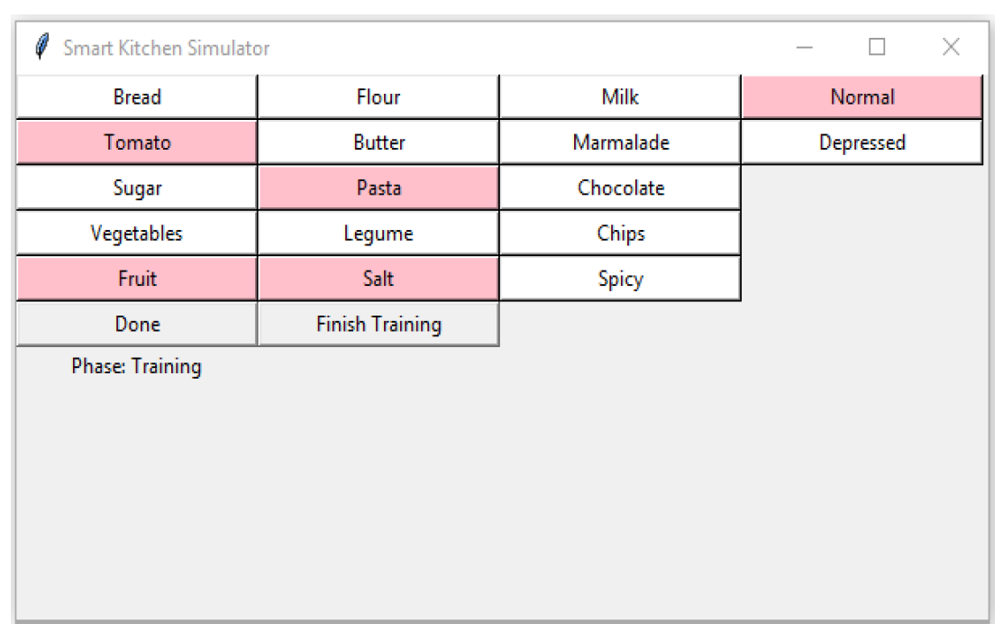
Smart Kitchen Simulator
(training phase)

Slide 42
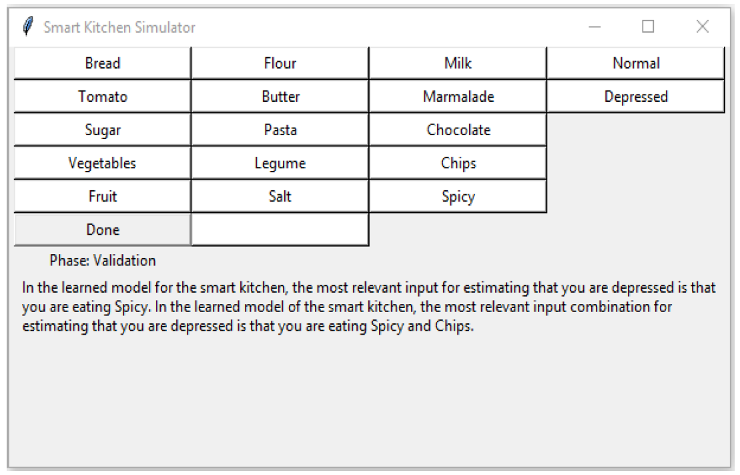
Auto-generated explanation for the learned model

Slide 43
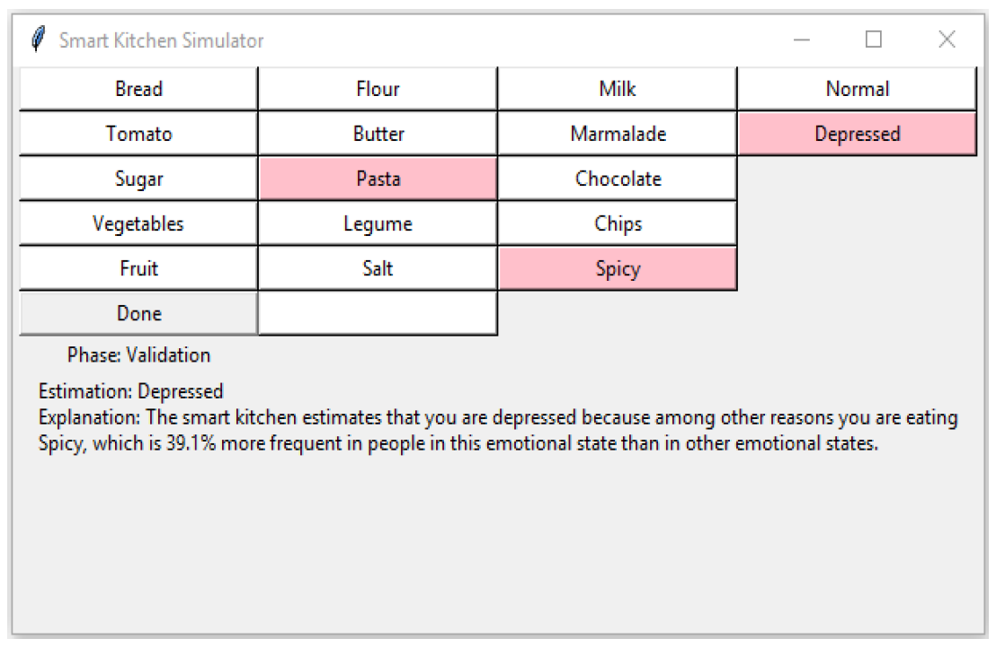
Auto-generated explanation for one meal

Slide 44
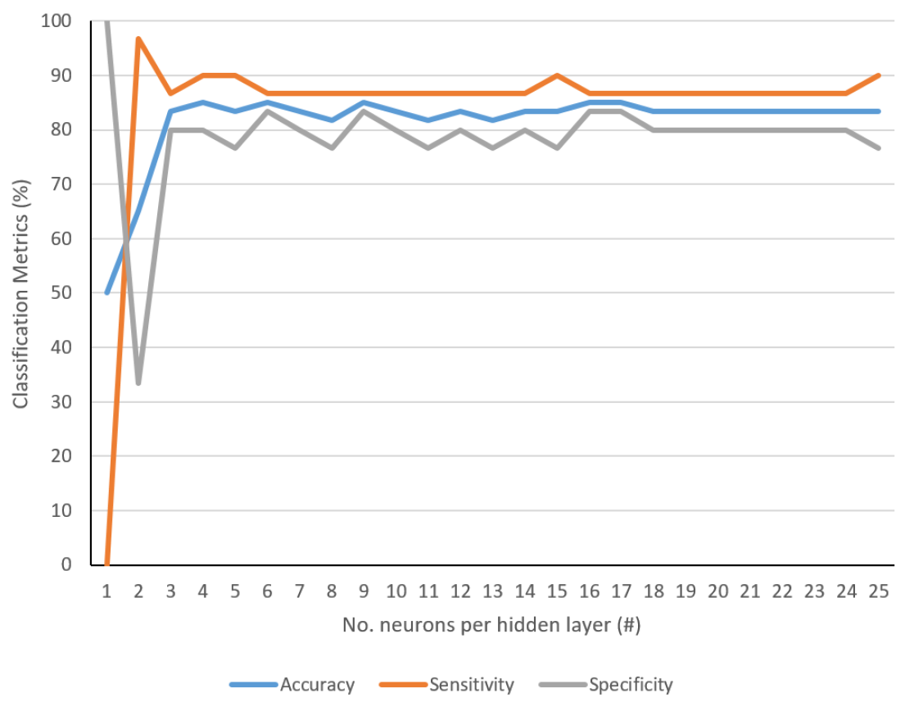
Adjusting Neural Network parameters

Slide 45
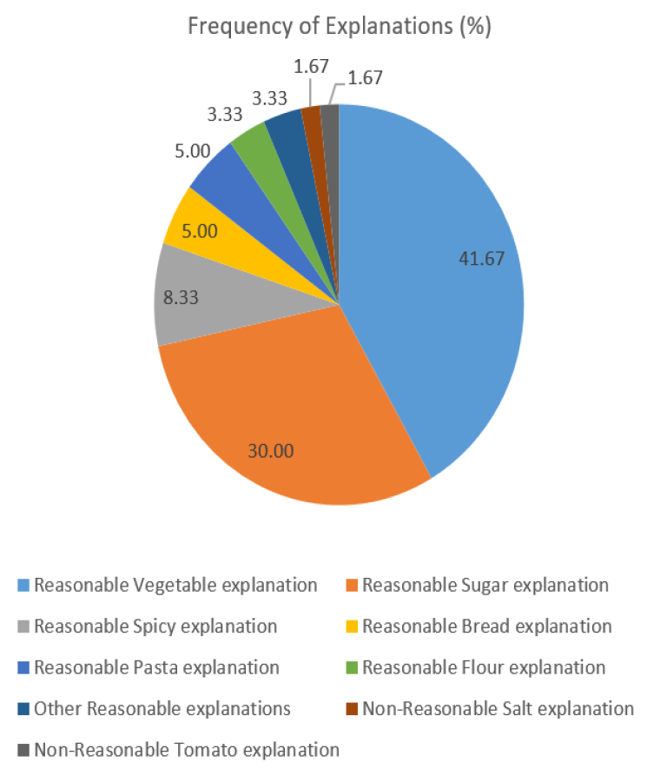
Results about HAI auto-generated explanations

Slide 46
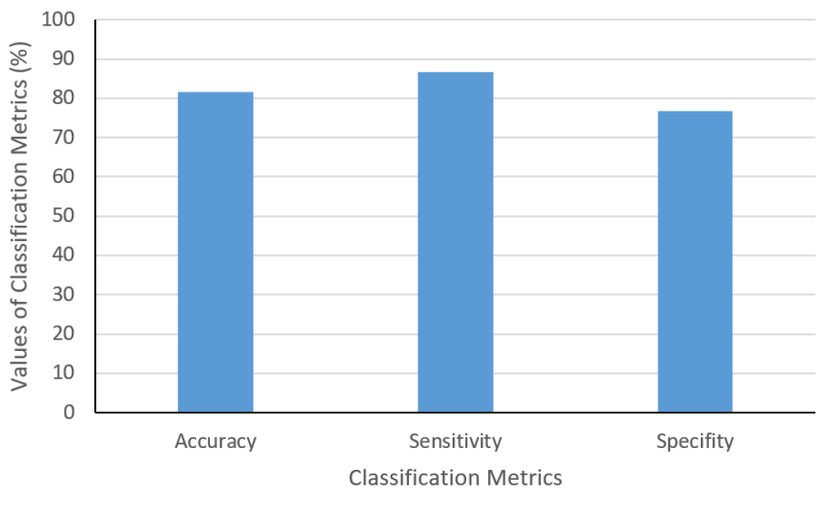
Classification Metrics Results

Slide 47
Conclusions and Future Work
IoT for tracking memory in Activities of Daily Life
Simulated navigation patterns
Real Smart-cupboards
Human-centric artificial intelligence can be applied (e.g. with explainable multi-layer perceptrons)
Future: Development of more techniques for measuring memory with IoT, E.g.:
  Smart taps
  Curtain sensors in doors

